Slide 1
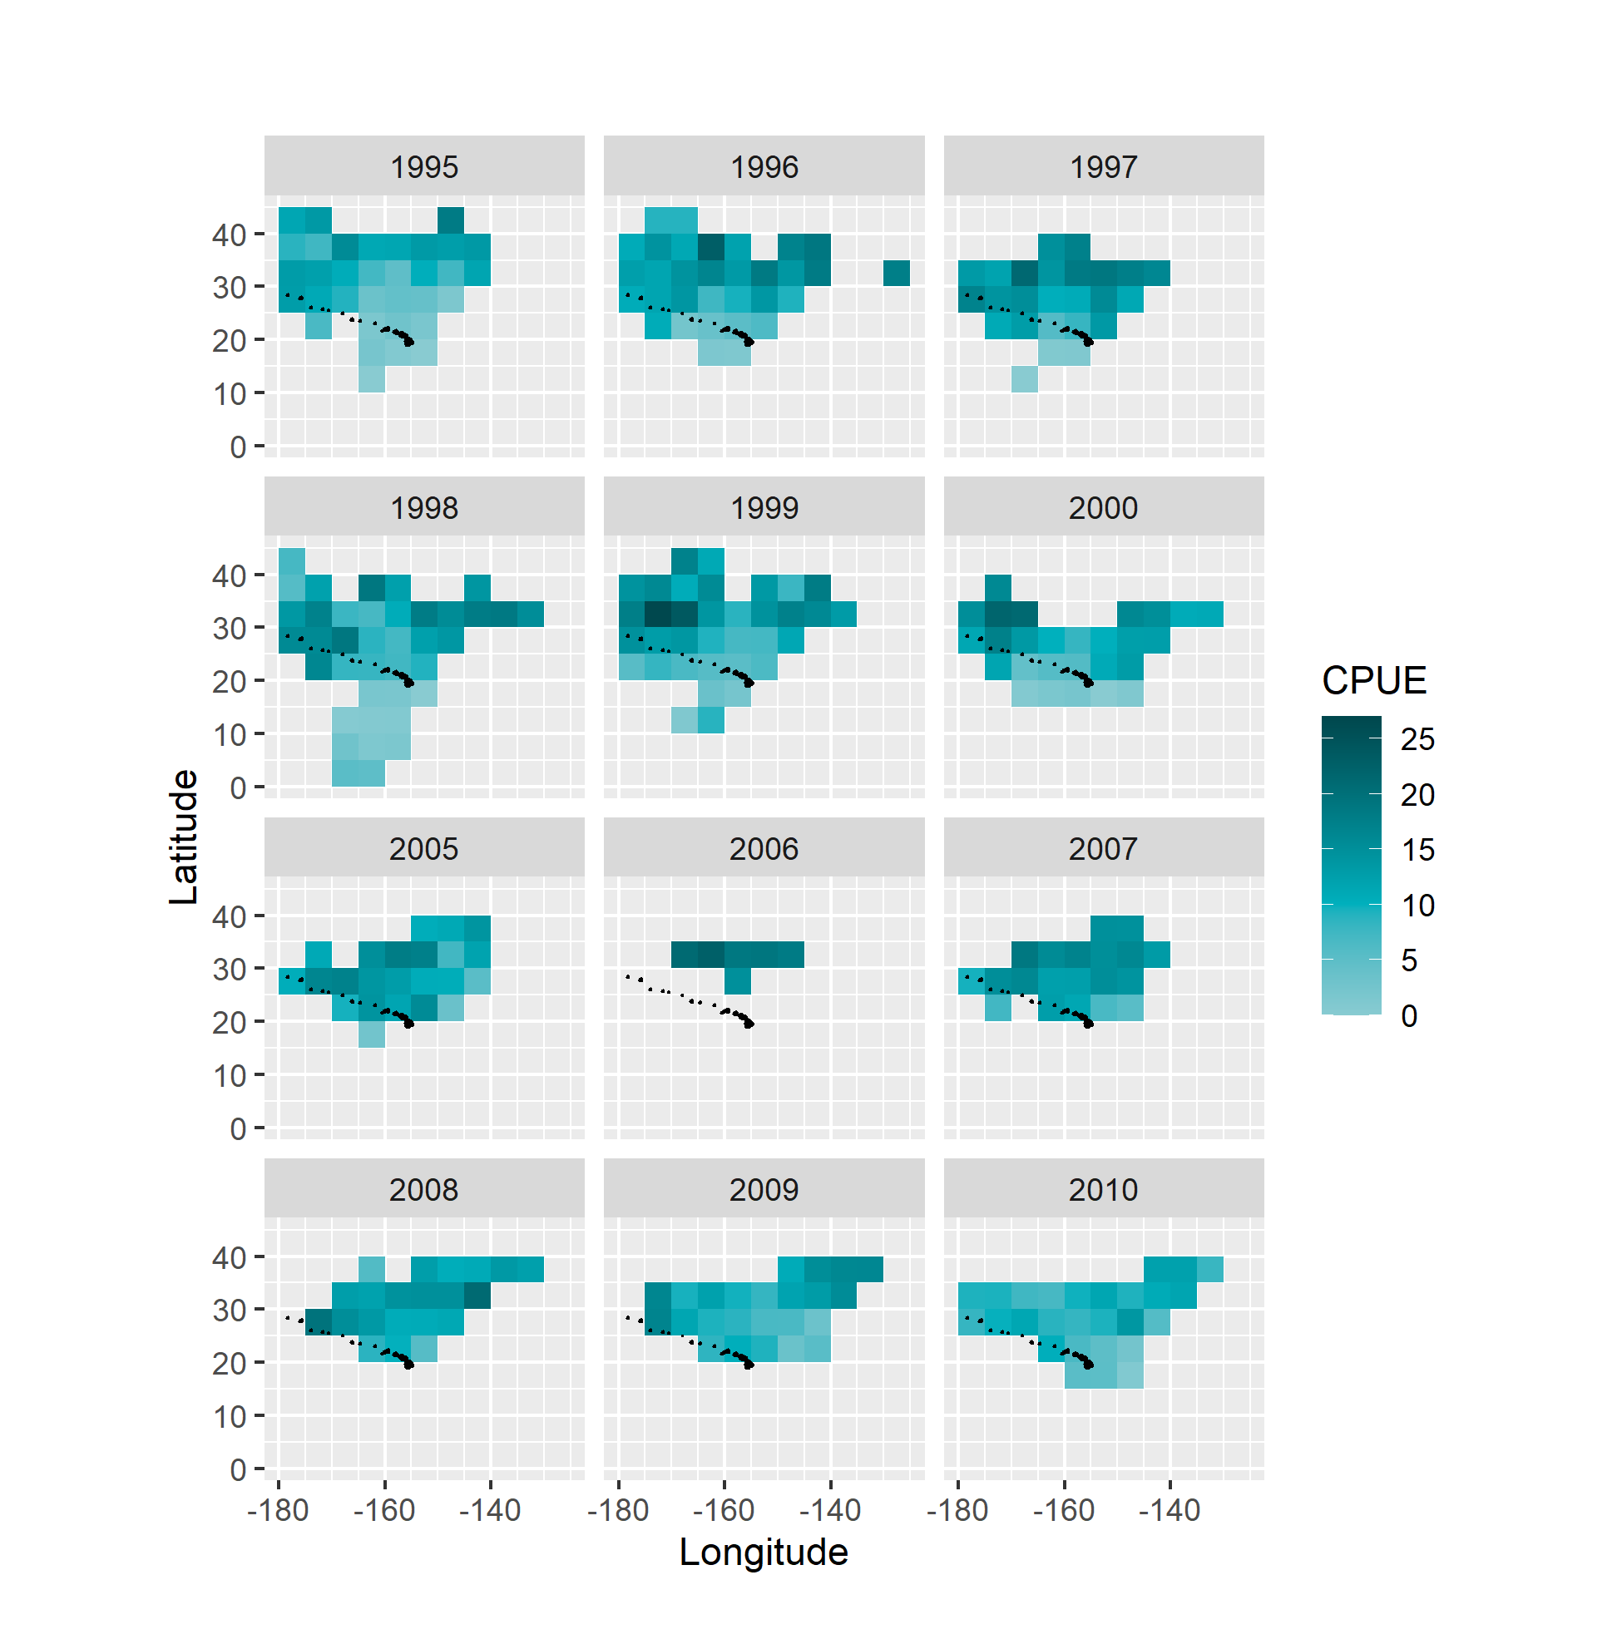
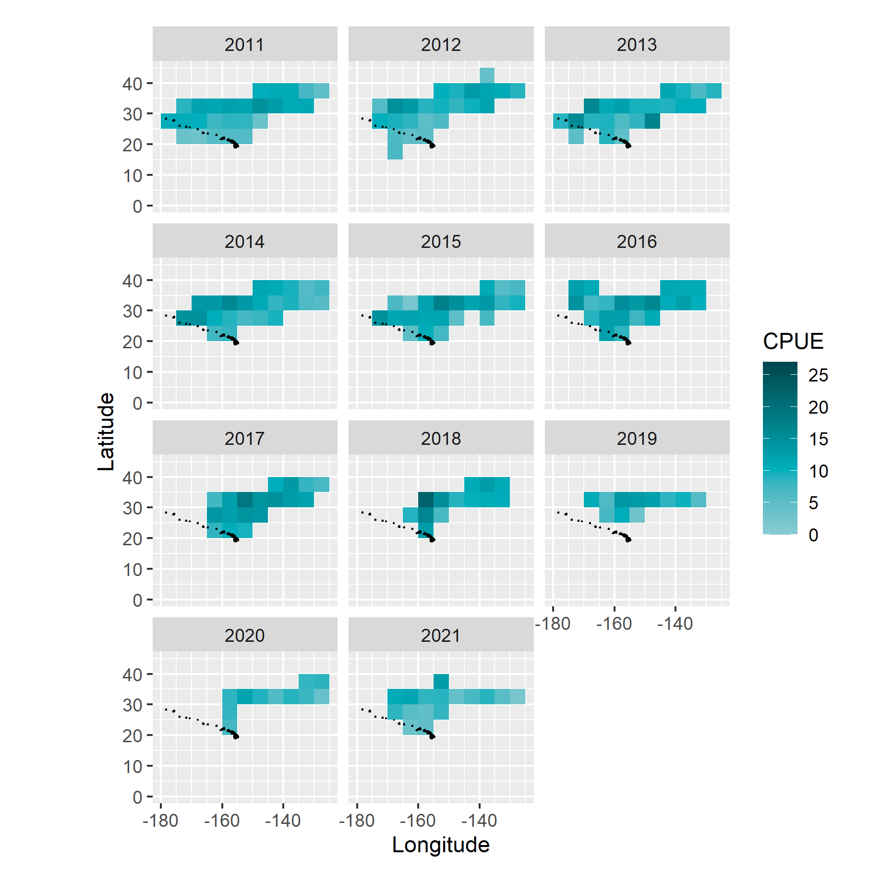
Shallow Set, 5 deg., by year
shrinking spatial extent of fishery, future improvements = standardization by gridcell (with imputation)

Slide 2
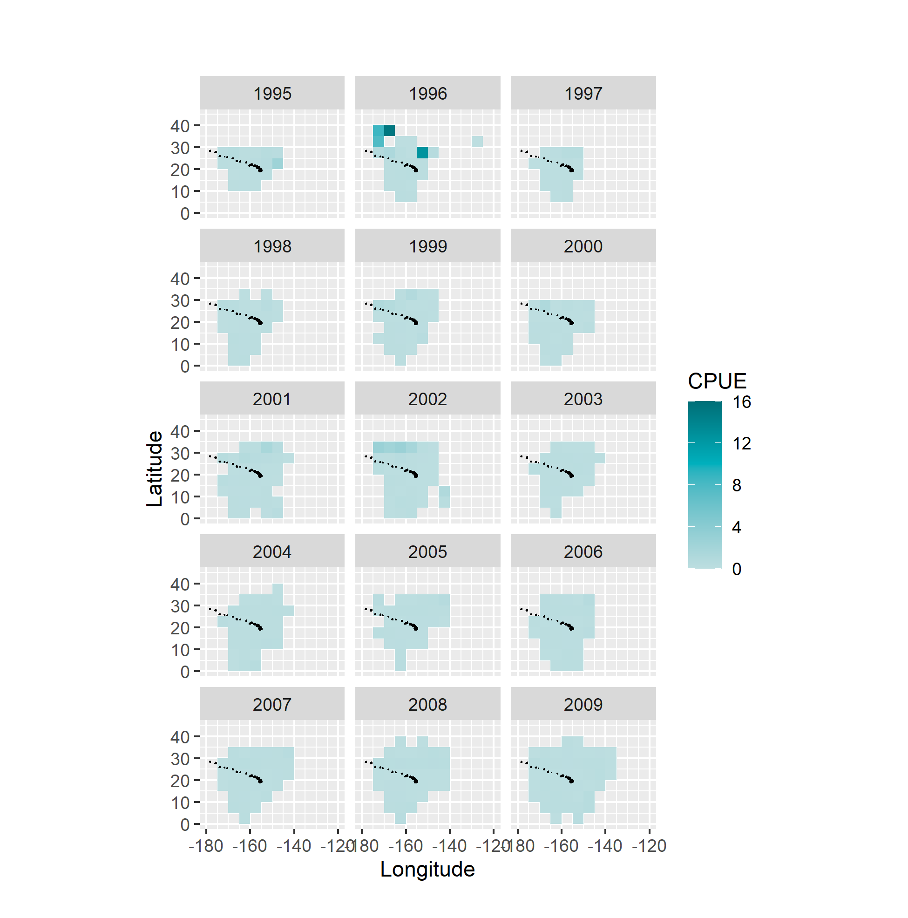
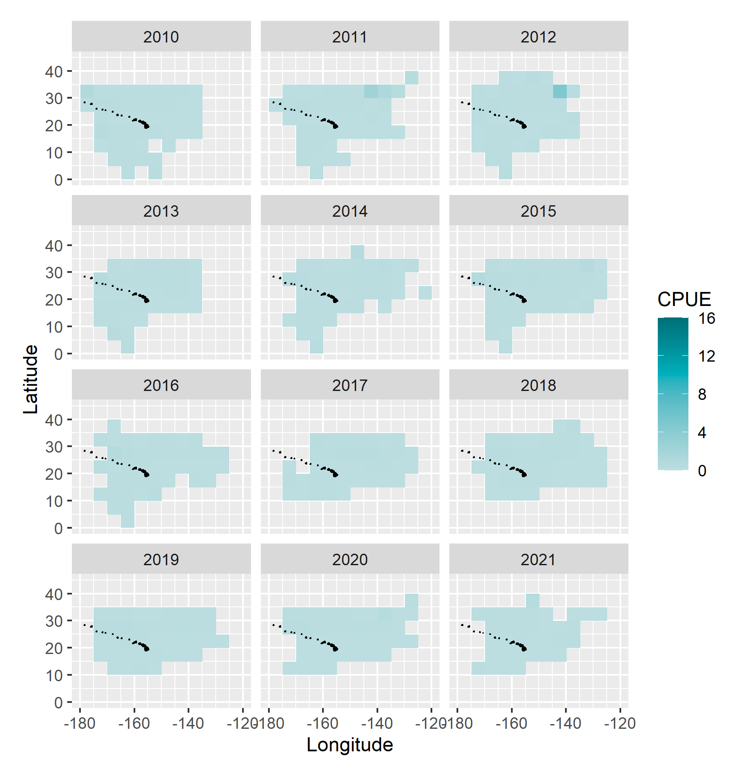
Deep set 5 deg.

Slide 3
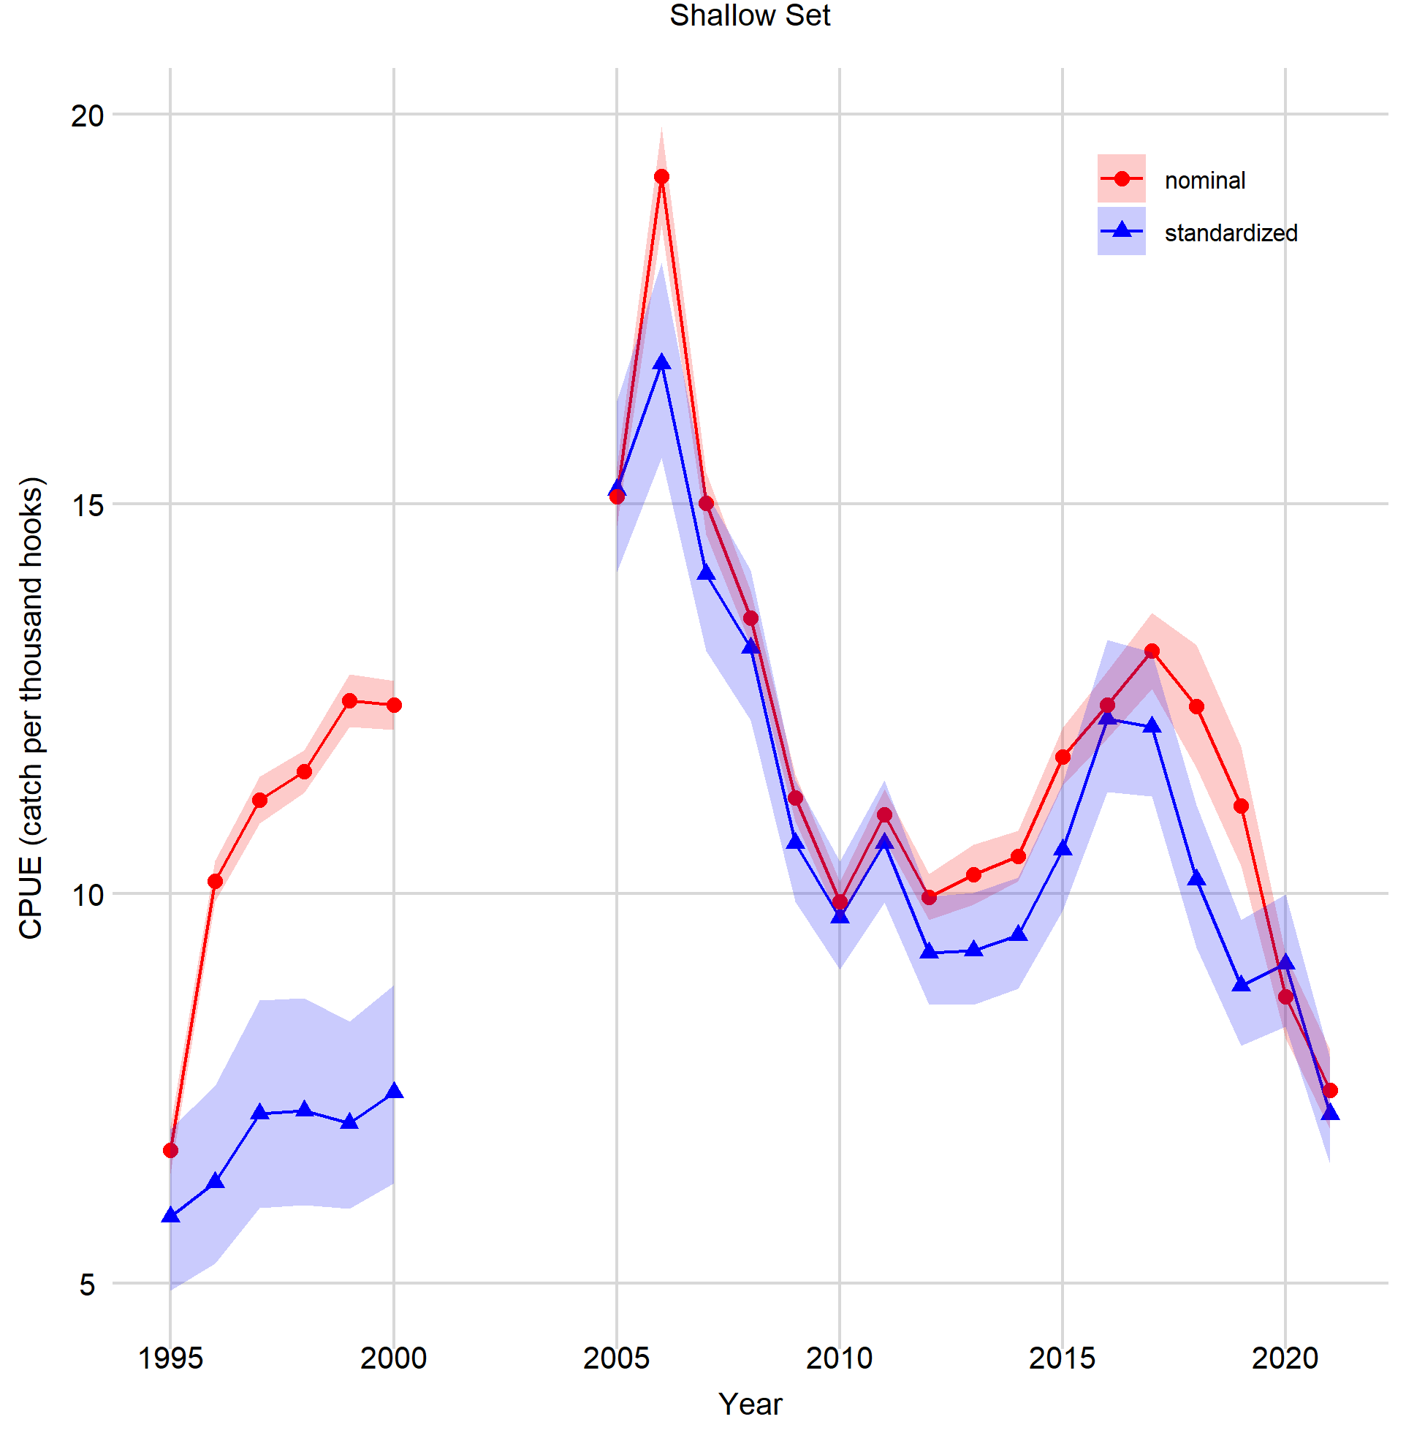
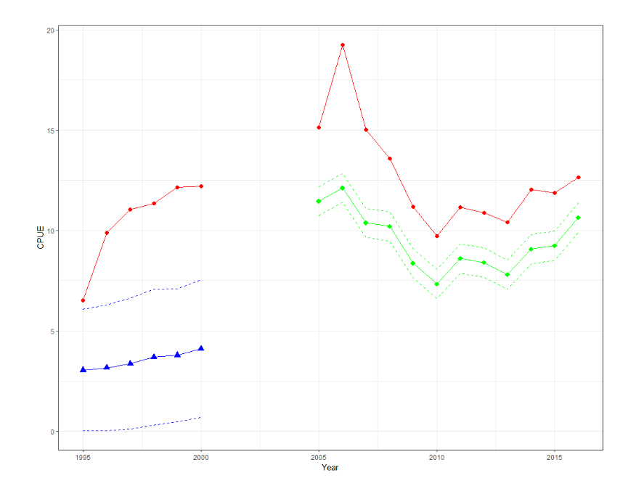
Shallow Set
Pretty similar to last assessment, but trajectory change 2016/2017.
I think shift in scales and slight differences probably due to finer seasonal changes (e.g. s(yday) marginal by month, not fixed by quarter).

Slide 4
Shallow Set
Form / Process | Model | % Deviance Explained | Comments
Shallow Set, 1995-2000 (14.7% zeros)
GAMM presence / absence | z ~ Year + (1|Permit) + s(Hour) + s(Yday) + s(Lat) + HPF_fac | 48.4 | Longitude and Moon were eliminated during model selection for failure to converge.
GAMM positive process | log(CPUE) ~ Year + (1|Permit) + s(Lat) + s(Yday) + s(Moon) + s(Lon) + s(Hour) + HPF_fac | 49.1
Shallow Set, 2005-2021 (1.1% zeros)
GAMM positive process | log(CPUE) ~ Year + s(Moon) + s(Yday) + SST + s(Lon) + s(Lat) | 34.4 | Adding a Lat*Lon tensor interaction increased deviance explained by 0.4%.
Null model was intercept only
Illum vs. Moon phase (see marginal effects plots later)
Quarter vs. YDay
Begin vs. Hour
Random Permit included a priori
Bait categories reduced
IDEAS (now or later)
Should MLD and SST be a smooth or category?

Slide 5
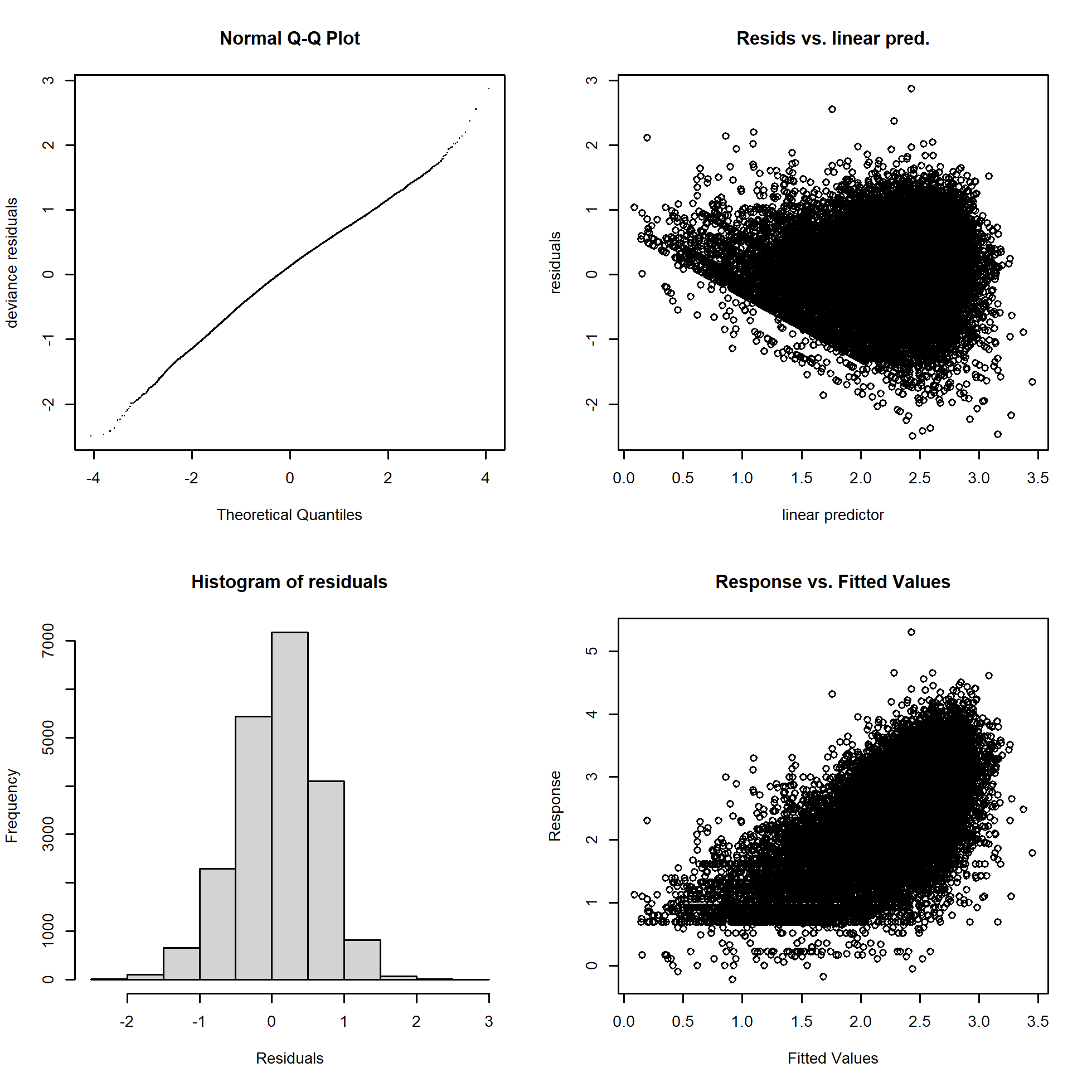
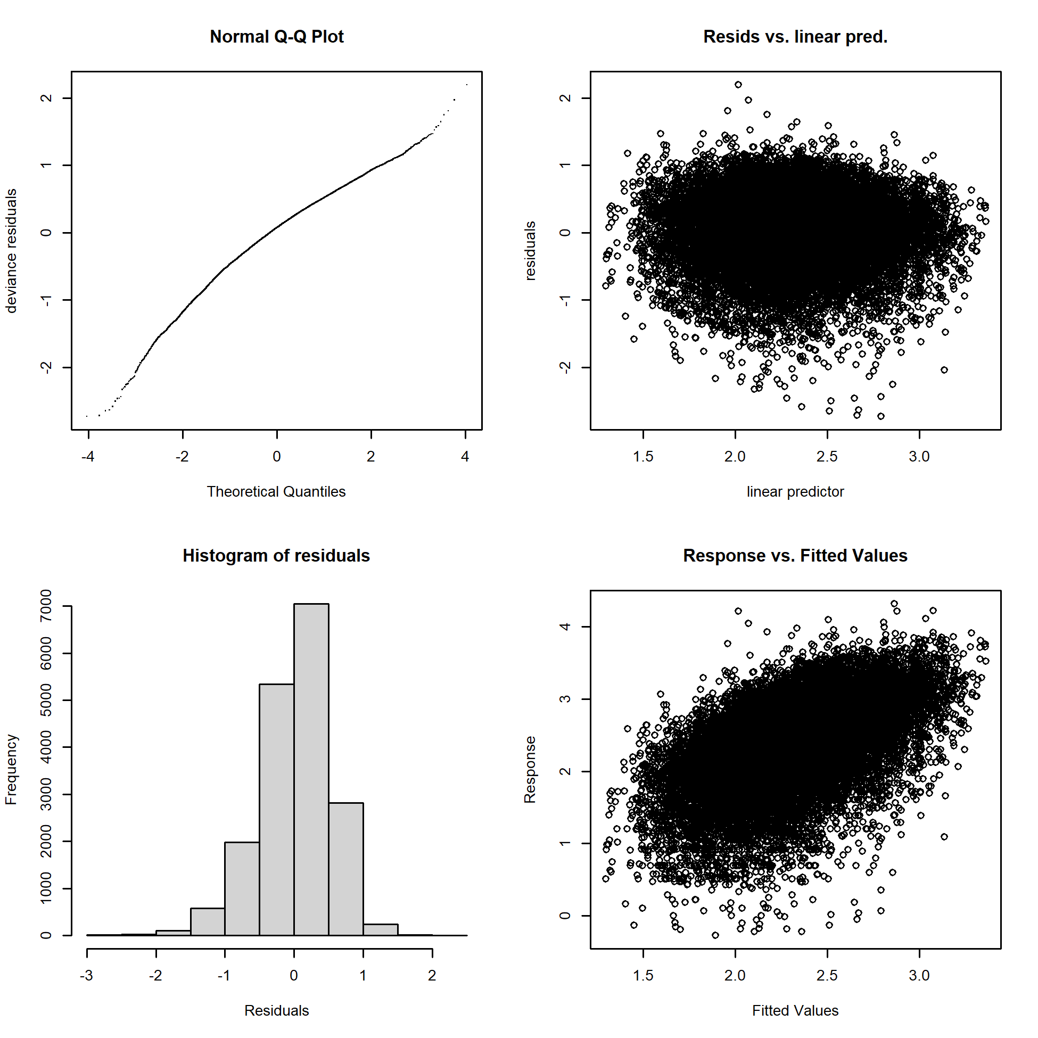
Shallow Set, positive process
Early, 1995-2000, LnN
Late, 2005-2021, LnN

Slide 6
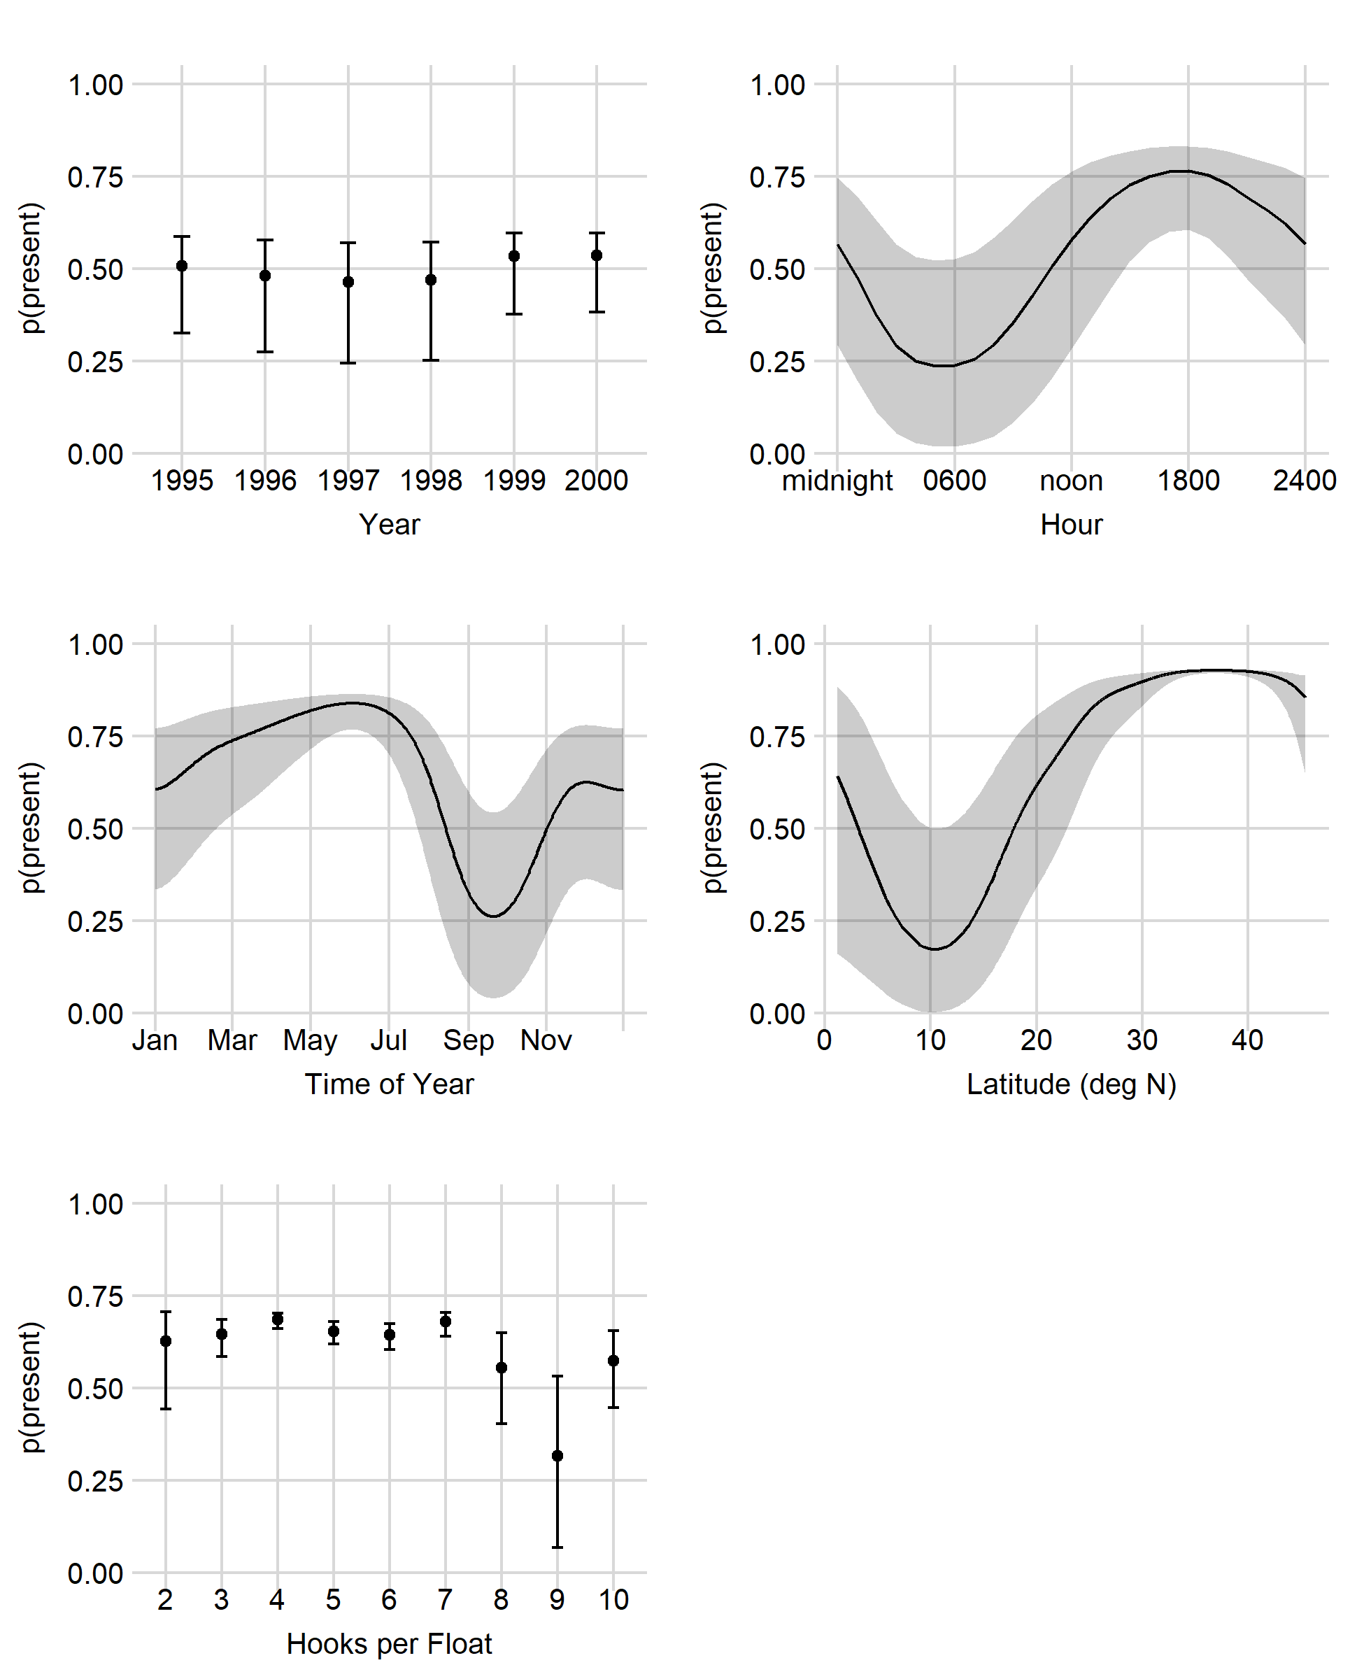
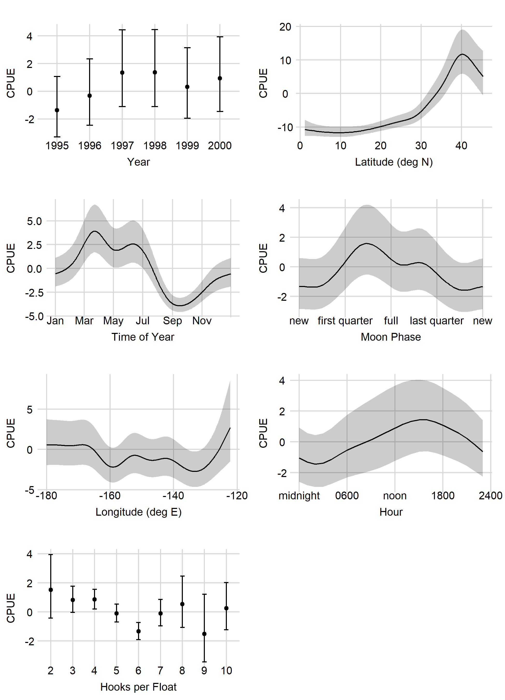
Binomial
Shallow Early Marginal Effects
LnN
Reduce k on longitude (and maybe time of year / moon)?
Does HPF make sense?

Slide 7
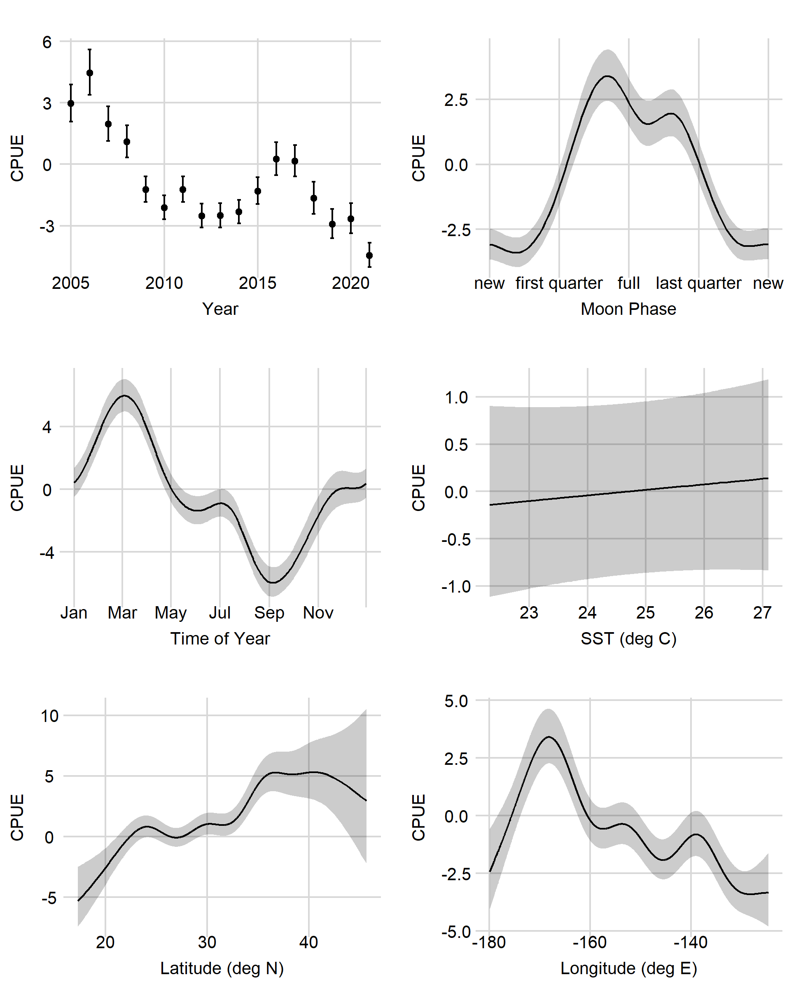
Shallow Late Marginal Effects
Reduce k on longitude (and maybe latitude)
SST not really doing anything

Slide 8
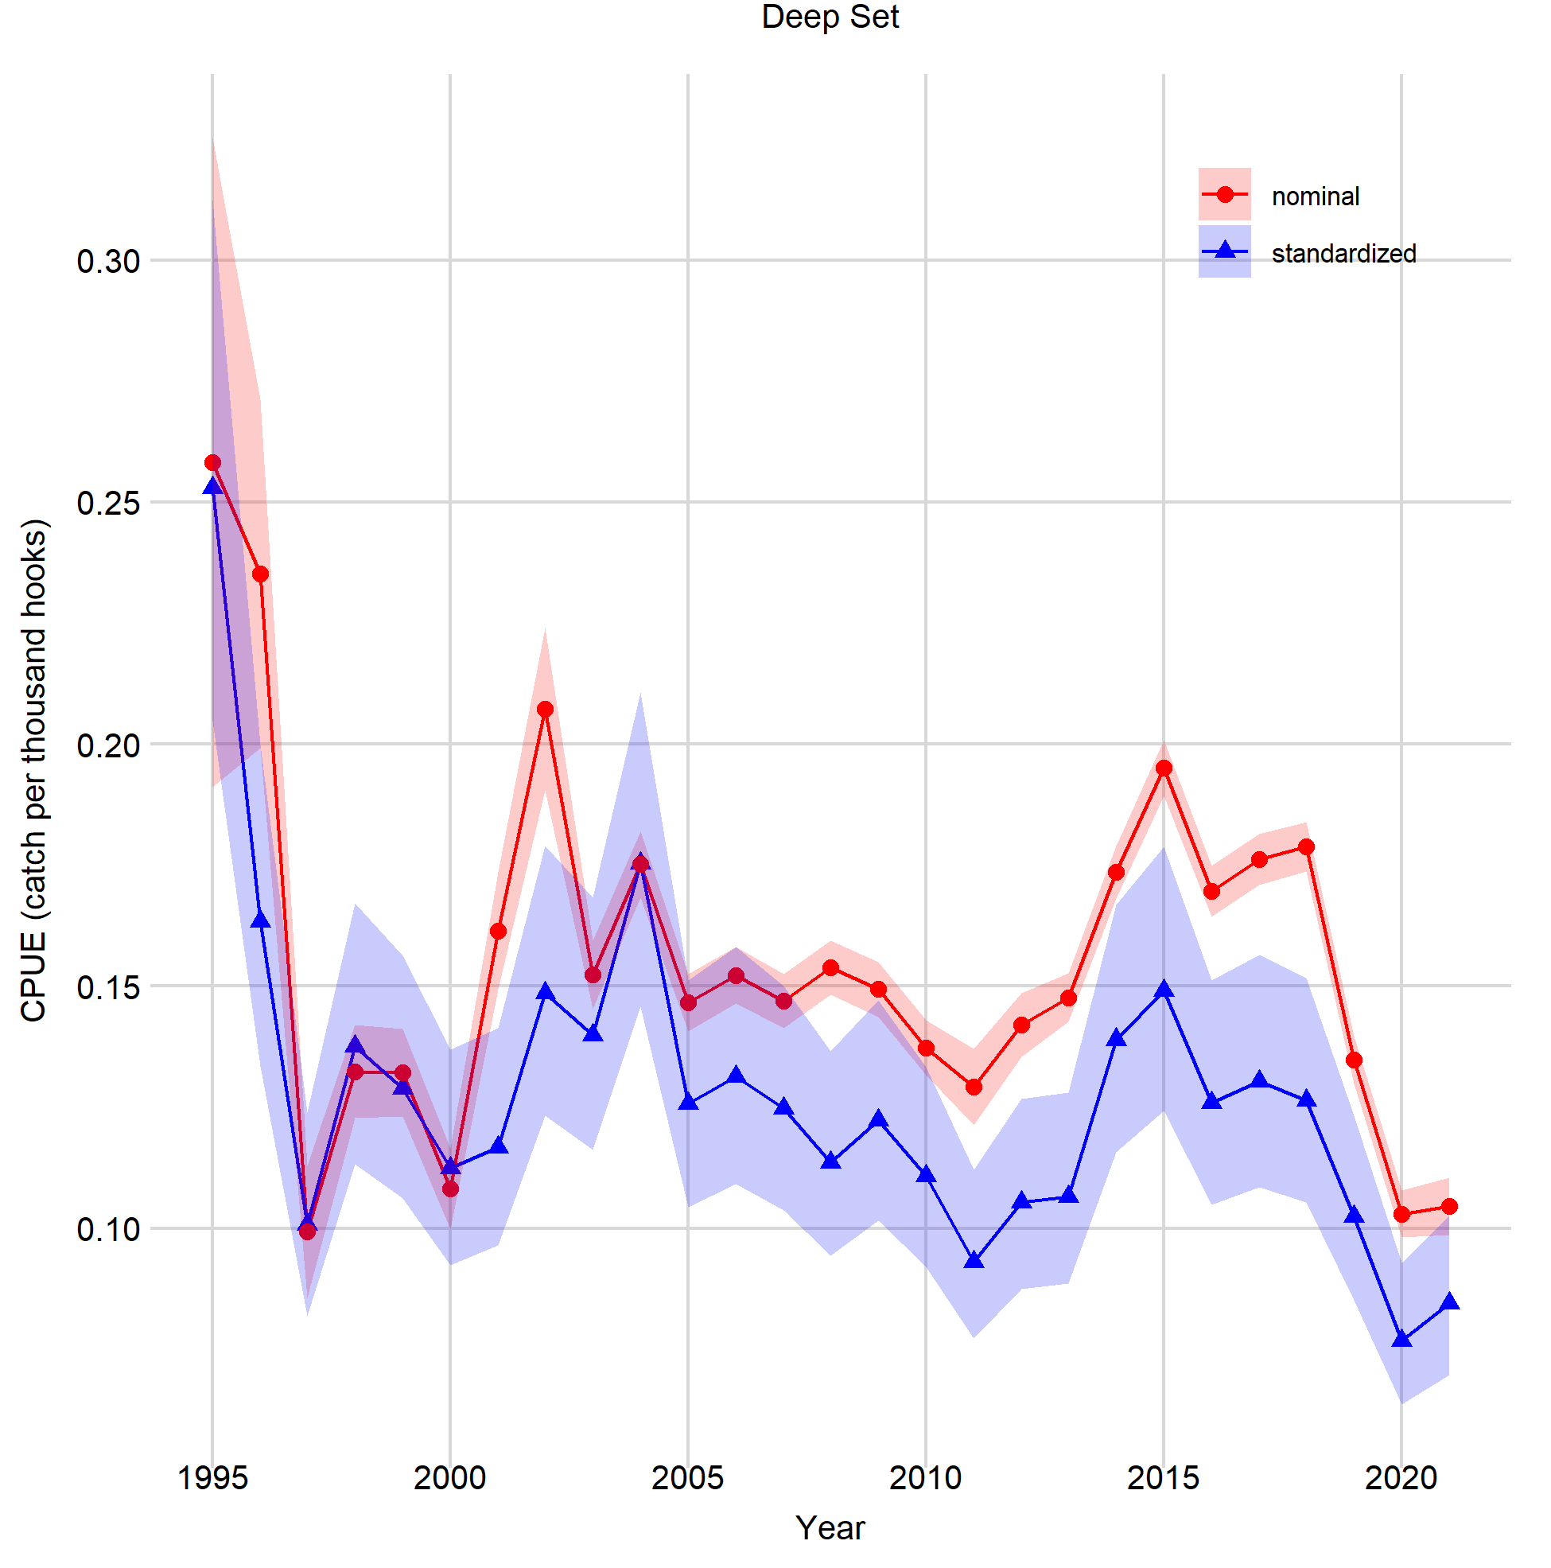
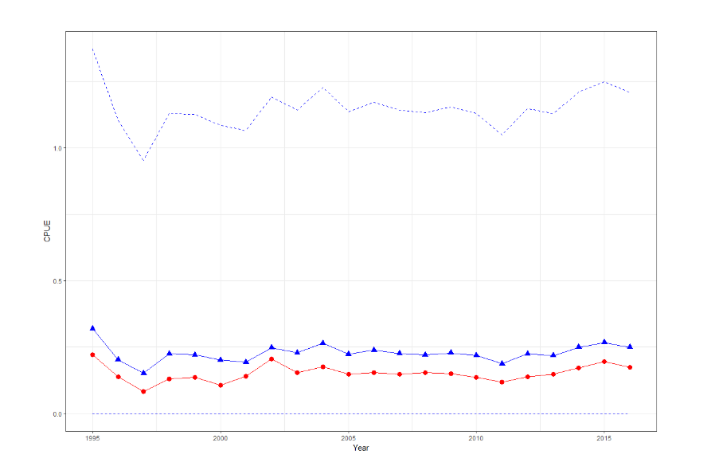
Deep Set

Slide 9
Deep Set
Form / Process | Model | % Deviance Explained | Comments
Deep Set, 1995-2021 (84.2% zeros)
GAMM presence / absence | z ~ Year + s(Yday) + SST + s(Lat) | 9.2 | Model selection performed using subset of data (5%)
GAMM positive process | log(CPUE) ~ Year + s(Hour) + s(Yday) + HPF_fac + s(Lat) + Bait_fac + SST | 32.5

Slide 10
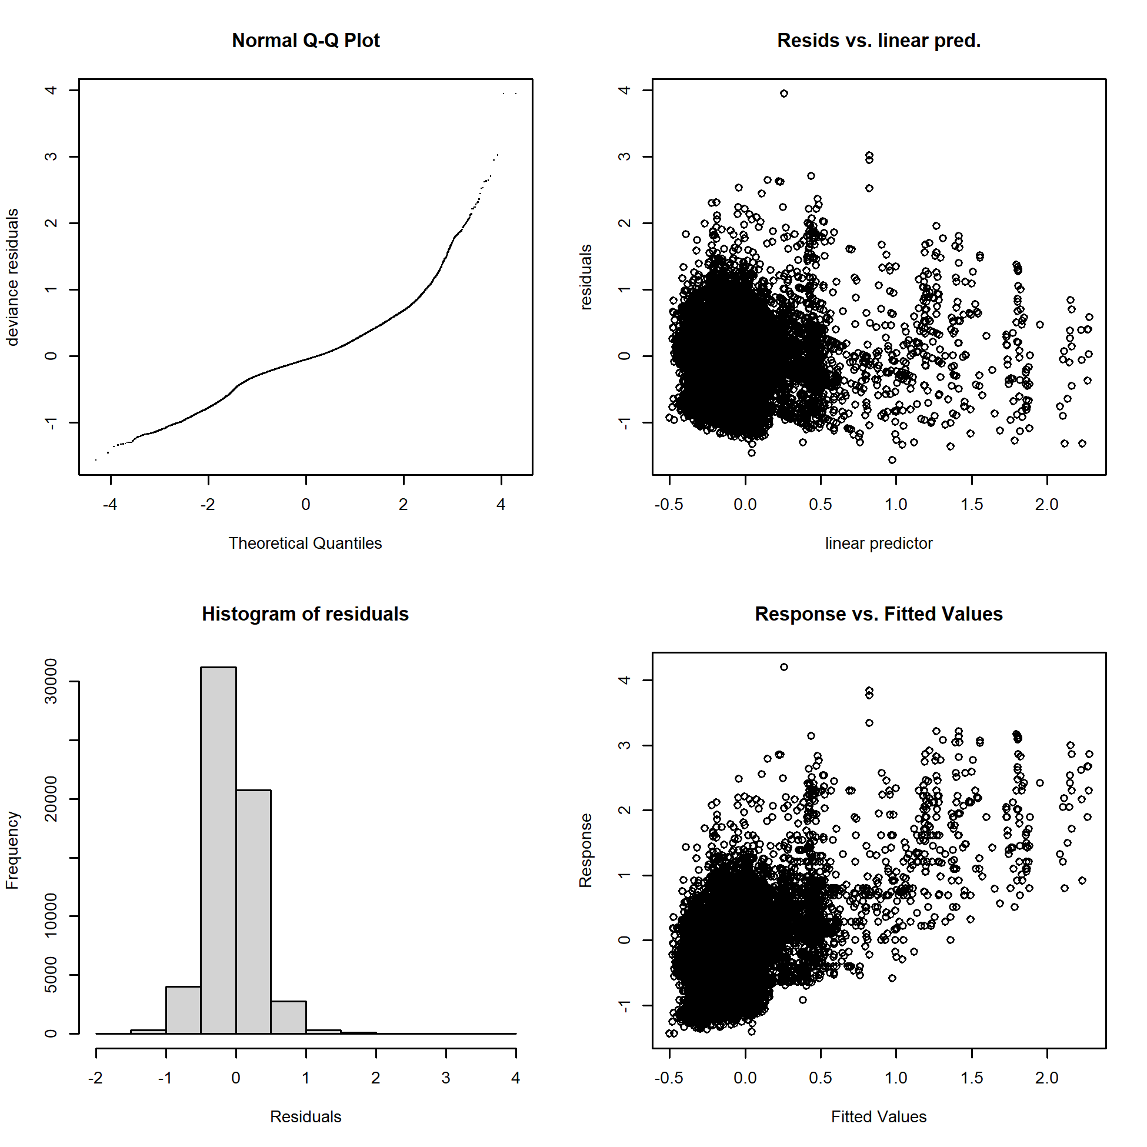
Deep Set
Positive process

Slide 11
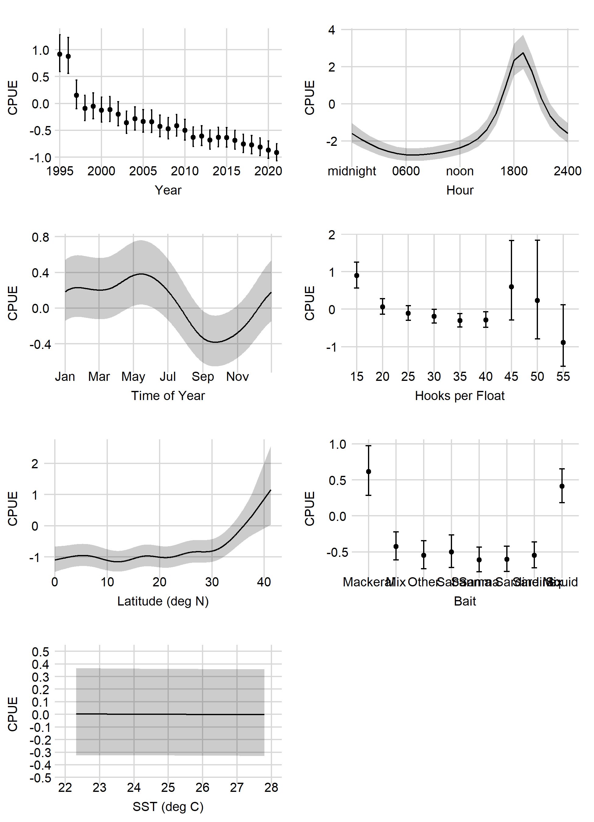
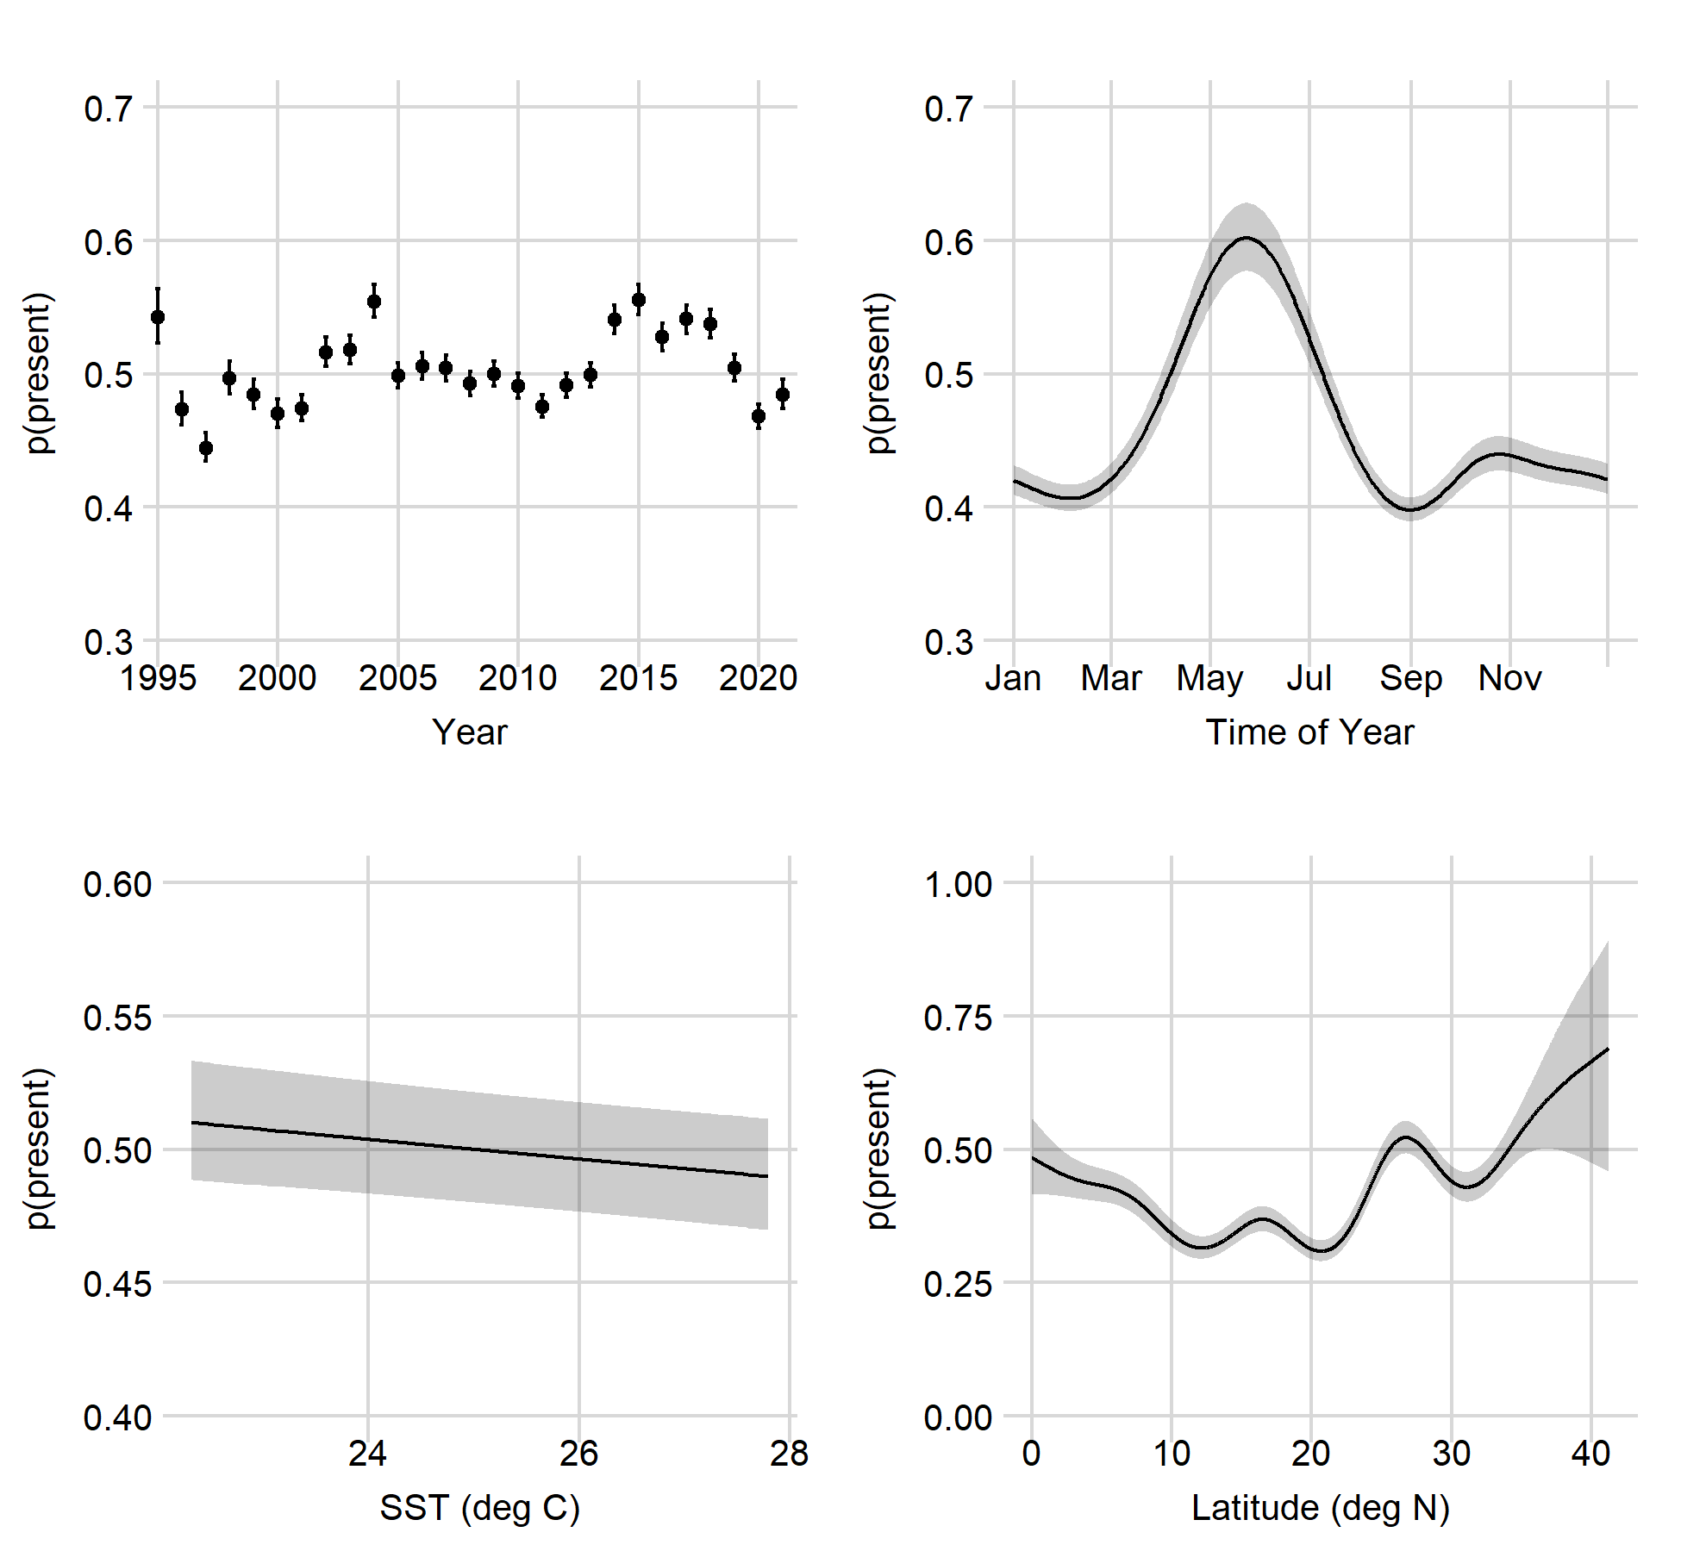
Deep Set Marginal Effects
LnN
Figure this out
Could be a HPF thing ->
Binomial
Question: do they try to avoid swordfish on the deepsets?
Are there any discards at sea?
Maybe simplify bait to mackerel, squid, all others.
Reduce k on latitude and longitude.
SST not doing much

Slide 12
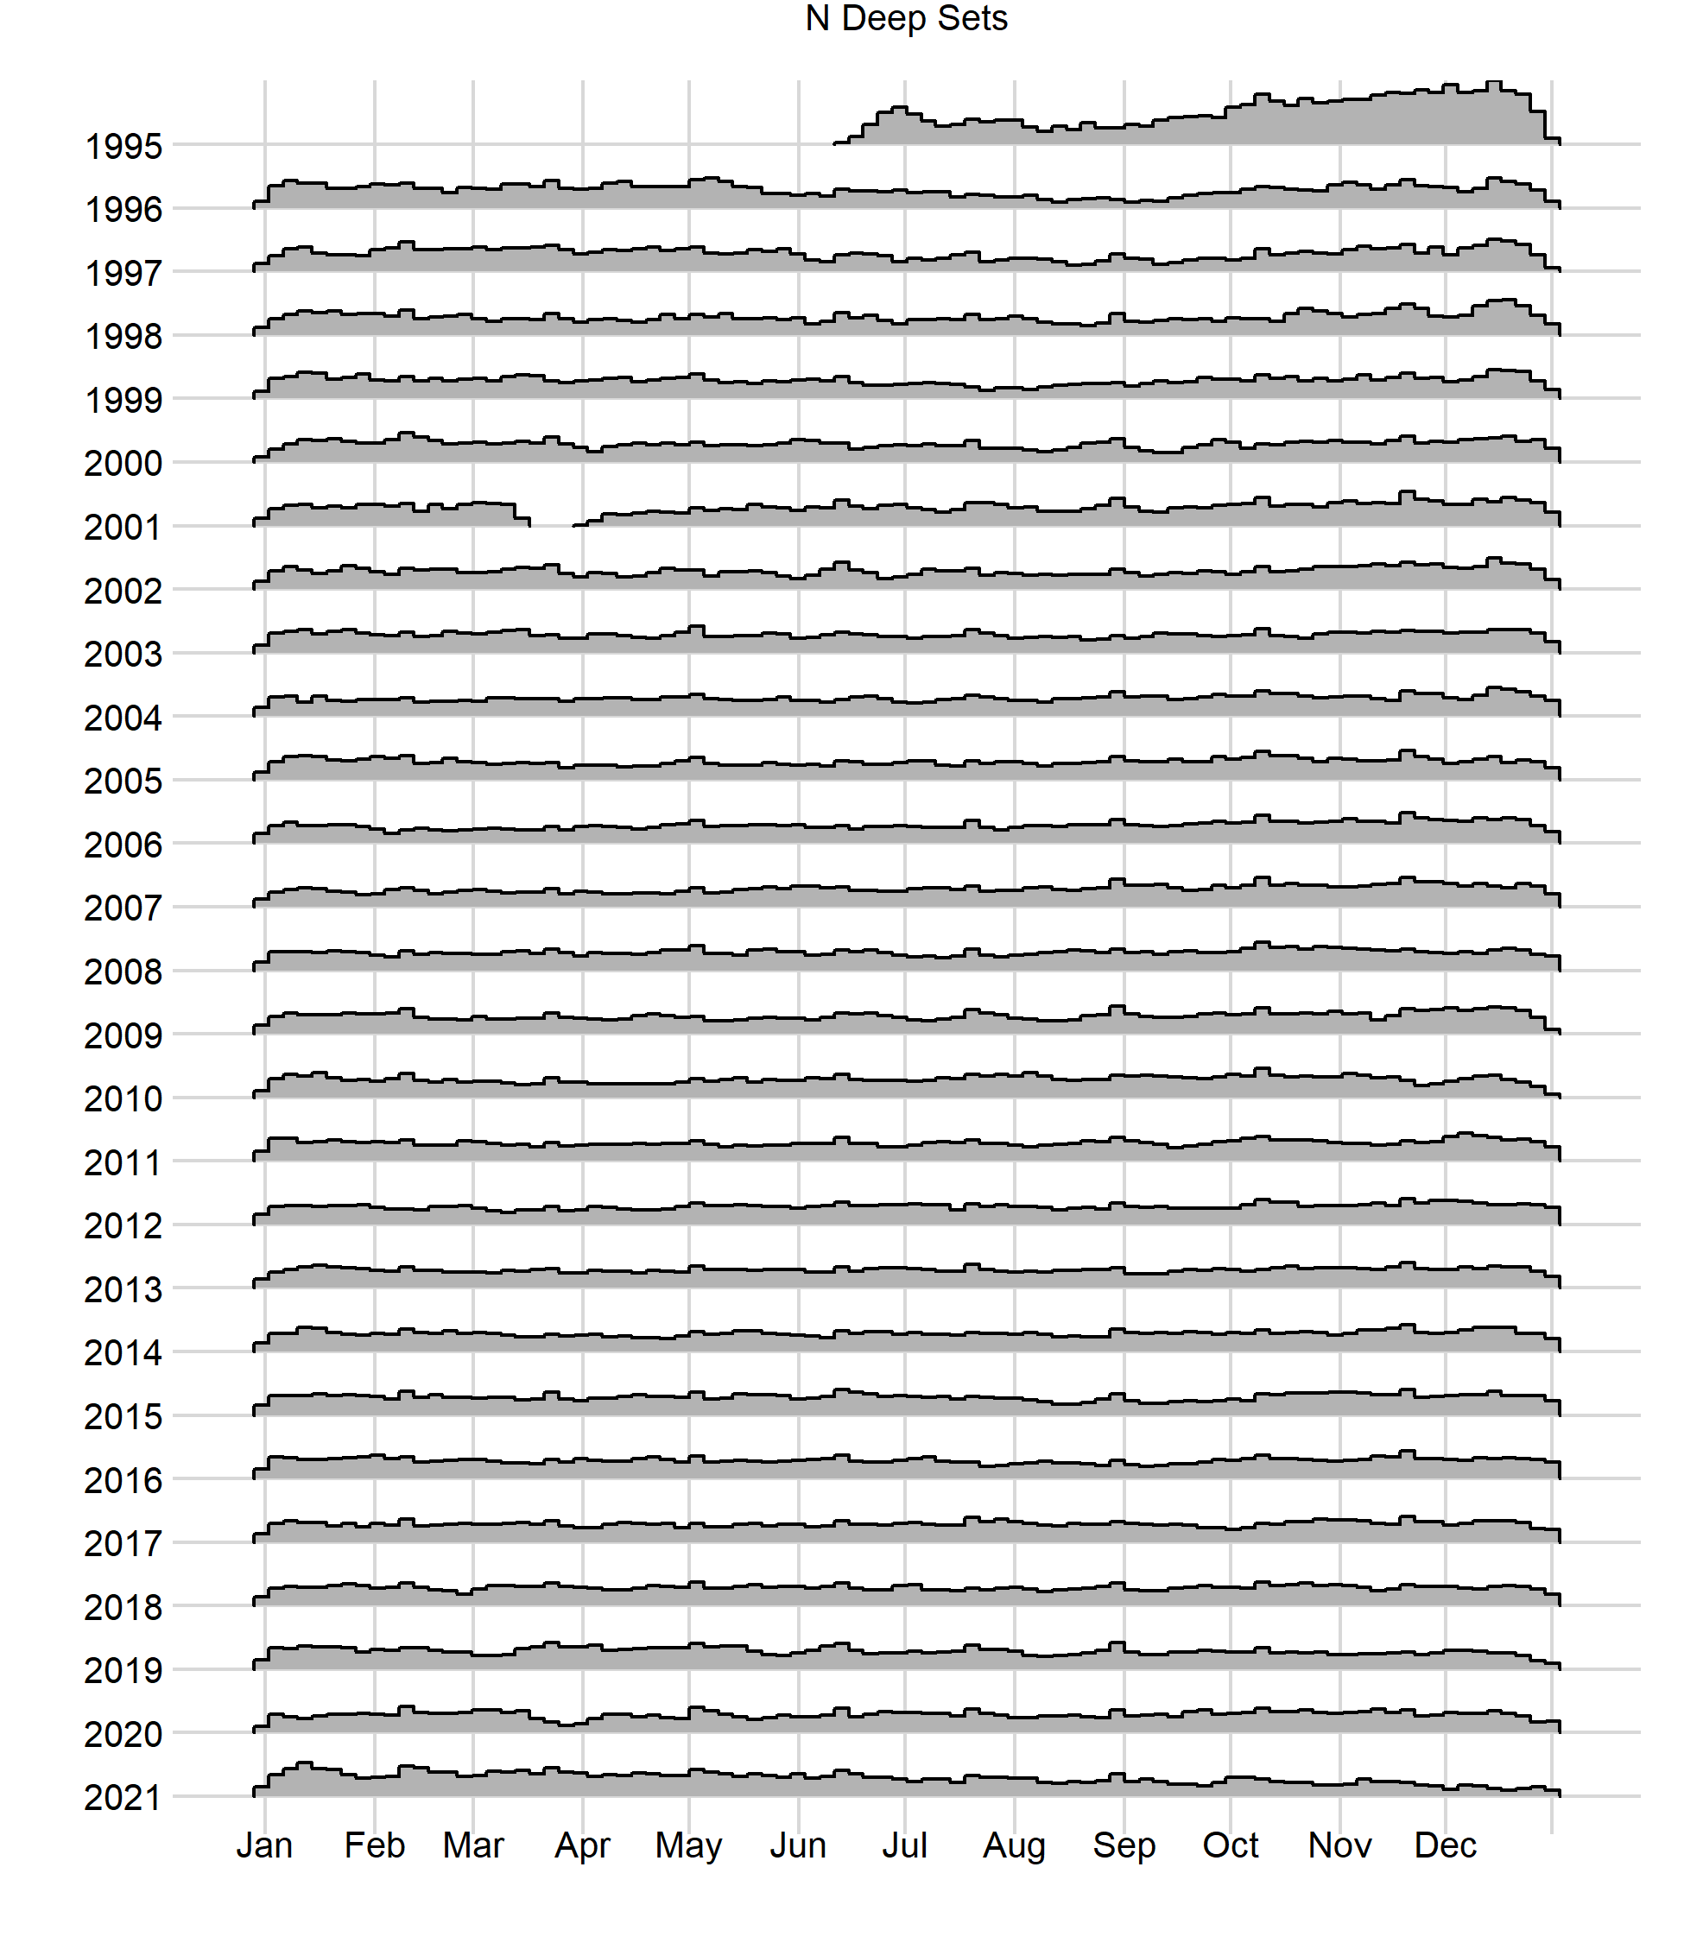
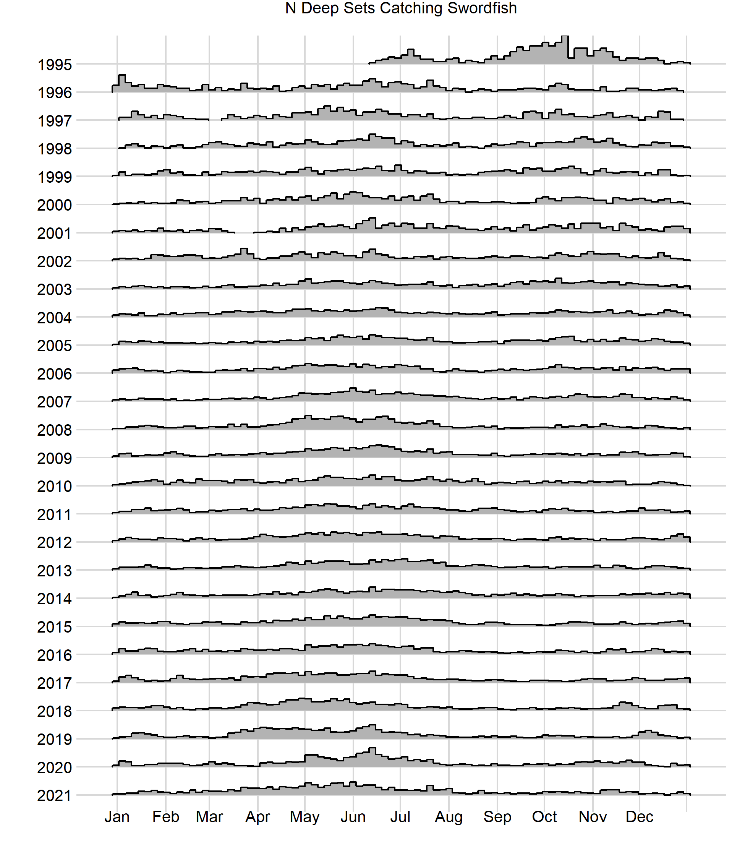

Slide 13
1995/1996 were strange years for deep set

Slide 14
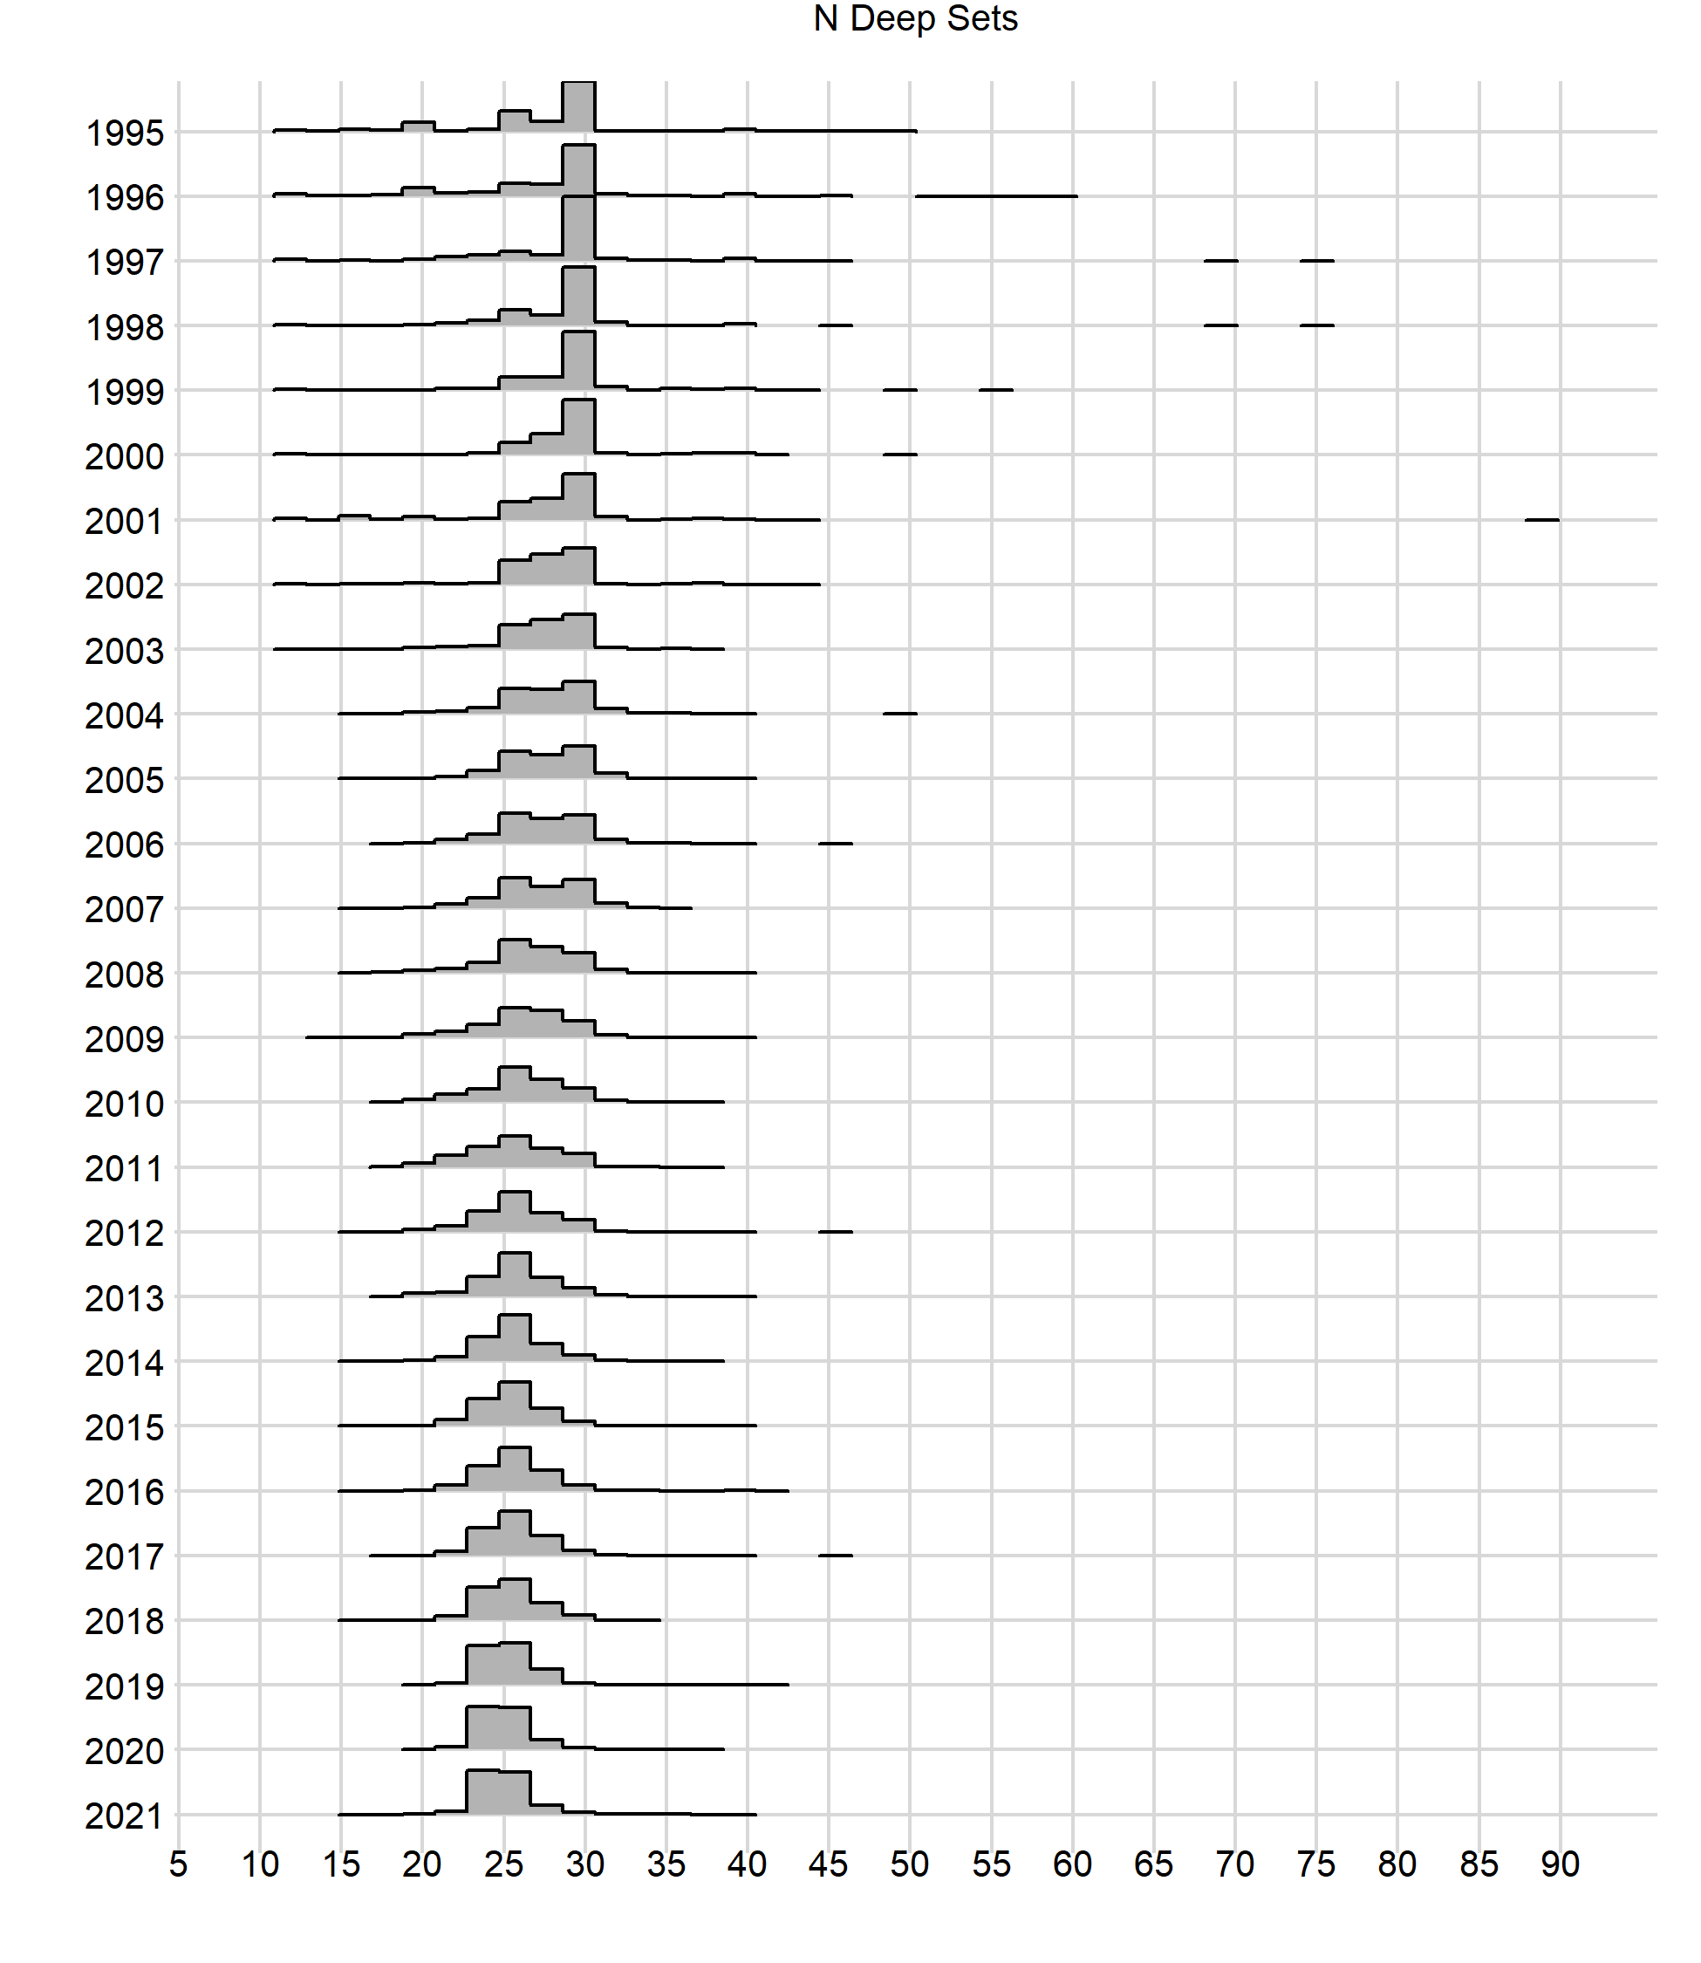
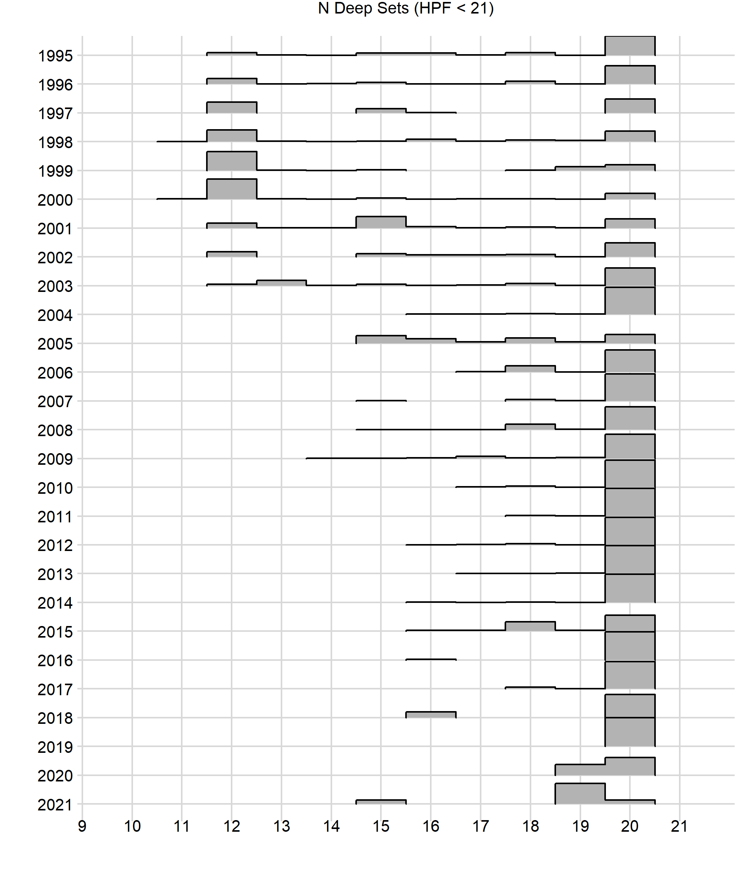
There were 891 sets with < 15 HPF before 2005. (Total deep sets over timeseries = 381,781). I suggest we remove those sets from the Deep set, but also exclude them from shallow set.

